Slide 1

Analyzing the Impact of Climate Change on Agricultural Productivity Using Statistical Methods
A Project Report
University Post Graduate College (OU) Secunderabad
A Constituent College of Osmania University
Department of Computer Science| M.Sc. Data Science II Year [2024-2026]
Submitted by
B.Manasa 101024559011
Under the Guidance of Dr. B. Ranganatha Rao
Assistant Professor,Dept of Computer Science

Slide 2
01
Introduction

Slide 3
Introduction
Agriculture is highly dependent on climate conditions such as temperature,rainfall,etc..
In recent years , Climate change is one of the major factors affecting agricultural productivity worldwide.
Variations in temperature, precipitation, and environmental conditions can significantly influence crop yield and food security.
This project analyzes the impact of climate change on agricultural productivity using statistical methods such as Correlation Analysis, Multiple Linear Regression, ANOVA, Trend Analysis, and the Kruskal–Wallis Test.
The study provides data-driven insights into climate-agriculture relationships and supports sustainable agricultural decision-making.
02

Slide 4
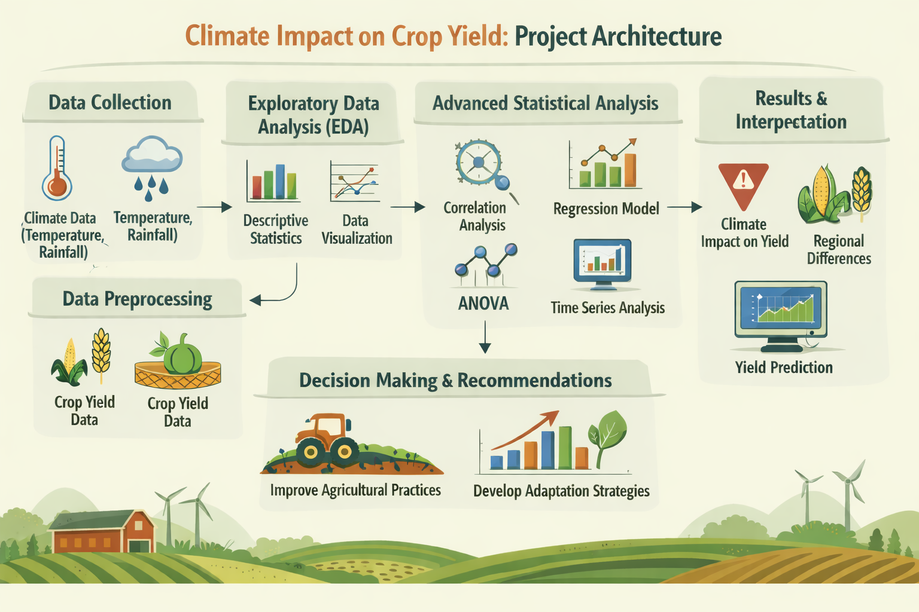
02

Slide 5
Research Objectives
Objective 1: Analyze the relationship between climate variables and crop yield using correlation coefficients and heatmap visualization.
Objective 2: Determine the impact of climate variables on crop yield and identify the most significant factors.
Objective 3: Compare agricultural productivity across countries, regions, crop types, and adaptation strategies.
Objective 4: To identify trends and patterns in agricultural productivity over time using crop yield data.
Objective 5: To evaluate the effectiveness of different adaptation strategies in maintaining agricultural productivity under changing climatic conditions.
F

Slide 6
Obj 1: Correlation Analysis
Pearson Correlation Analysis
Analyze the relationship between climate variables and crop yield using correlation coefficients and heatmap visualization.
Strongest Correlation
r = 0.264
Key Findings
Temperature vs Crop Yield
• Temperature: r = 0.264 (strongest positive link)
• Precipitation: weak positive relationship
• CO2 Emissions: weak negative relationship
• Irrigation Access: negligible relationship
• Soil Health Index: negligible relationship
Outputs Generated
• Correlation Matrix
• Correlation Heatmap
• Correlation Coefficients (r)
07

Slide 7
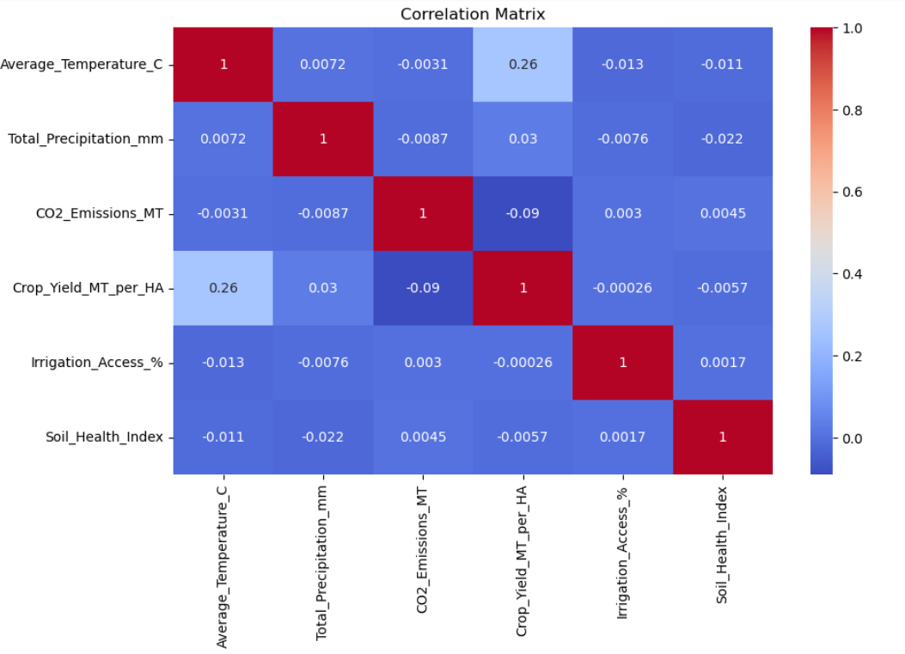
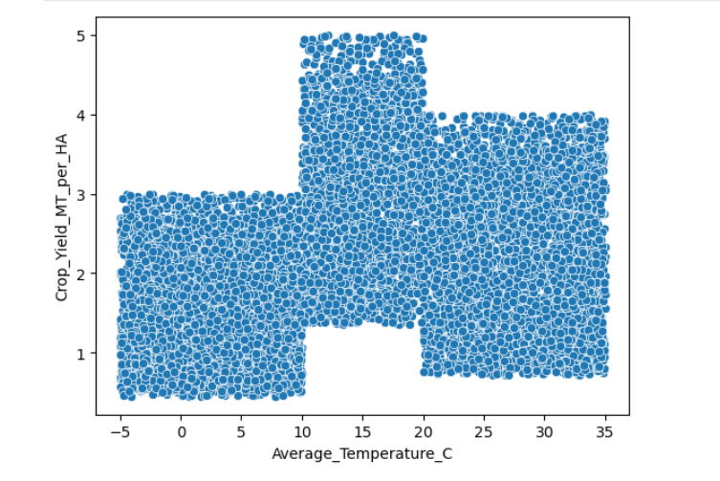
Correlation Heatmap
The heatmap is simply a visual version of the correlation matrix.
Instead of numbers alone, colors represent the strength of relationships:
🟢 Dark Positive Color → Strong Positive Correlation
🔴 Dark Negative Color → Strong Negative Correlation
⚪ Light Color → Weak or No Correlation
The heatmap makes it easier for the examiner to quickly identify important relationships.
Result
Temperature was identified as the most influential climate variable affecting crop yield.
Climate factors impact agricultural productivity, but their influence is moderate and depends on multiple interacting factors.

Slide 8
Obj 2: Multiple Linear Regression
Multiple Linear Regression
Determine the impact of climate variables on crop yield and identify the most significant factors.
R-Squared Score
MAE
RMSE
0.0679
Evaluated
Evaluated
6.79% variance explained
Mean Absolute Error
Root Mean Square Error
Key Finding
Climate variables collectively influence crop yield. Temperature was identified as the most important factor affecting agricultural productivity.
08

Slide 9
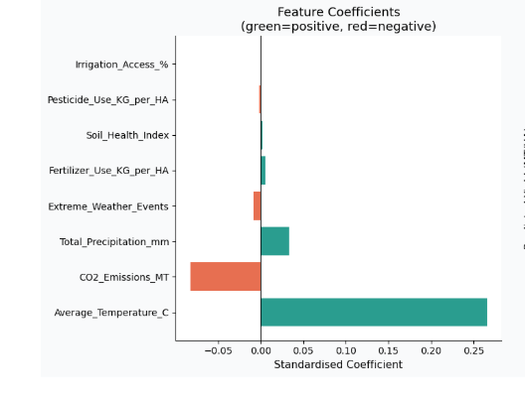
"The R² Score of 0.0679 indicates that climate and agricultural variables explain about 6.79% of the variability in crop yield. This suggests that crop yield is influenced not only by the variables included in the dataset but also by other external factors."
"MAE was used to measure the average prediction error of the regression model."
RMSE measures prediction error similar to MAE but gives more weight to larger errors.
Results
Temperature is the most important predictor of crop yield.
CO₂ emissions are the strongest negative predictor.
Regression analysis confirms that climate variables influence agricultural productivity.
The model quantifies the contribution of each factor affecting crop yield.
What does the graph show?
The graph shows the importance and direction of influence of each feature on Crop Yield.
Green bars = Positive effect on crop yield.
Red bars = Negative effect on crop yield.
Longer bars = Stronger influence.
Shorter bars = Weaker influence.

Slide 10
Obj 3: ANOVA Analysis
Analysis of Variance
Compare agricultural productivity across countries, regions, crop types, and adaptation strategies.
Outputs
• F-statistic
• p-value
• Eta Squared (eta2)
• Boxplot Visualizations
Effect Size:
Eta Squared measures variation explained by each factor
Comparison Group | F-statistic | p-value | Significance
Countries | 0.4532 | 0.9061 | Not Significant
Regions | 0.8977 | 0.6359 | Not Significant
Crop Types | 1.4774 | 0.1498 | Not Significant
Adaptation Strategies | 0.9852 | 0.4142 | Not Significant
Key Finding: No statistically significant differences in crop yield across any comparison groups
09

Slide 11
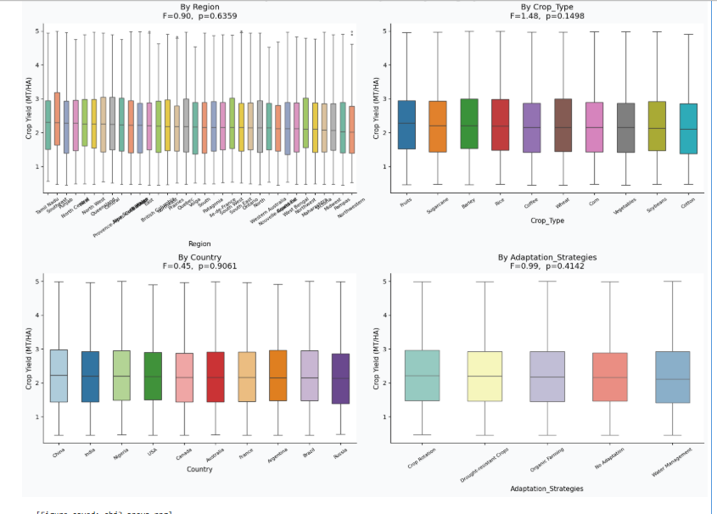
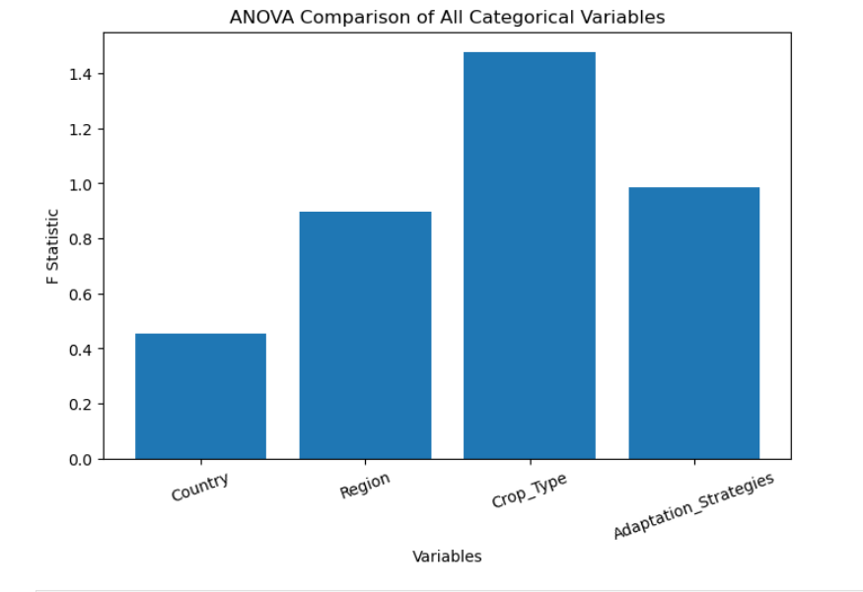
Observation
The ANOVA test was conducted to compare crop yield across regions, crop types, countries, and adaptation strategies.
All p-values are greater than 0.05.
The boxplots show similar median crop yield values and overlapping distributions across categories.
No category exhibits a substantial difference in agricultural productivity.
Result
Since all p-values are greater than the significance level (α = 0.05), the null hypothesis cannot be rejected for any comparison group.
Therefore:
Region does not significantly affect crop yield.
Crop Type does not significantly affect crop yield.
Country does not significantly affect crop yield.
Adaptation Strategies do not significantly affect crop yield.

Slide 12
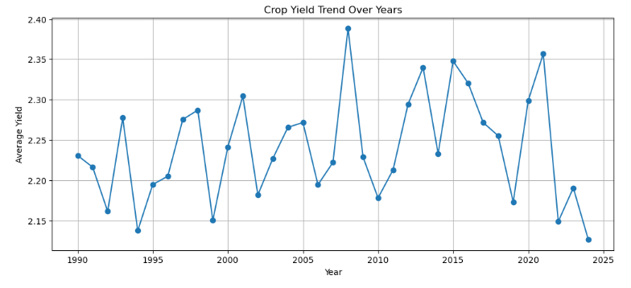
Obj 4: Trend Analysis
Trend Analysis
To identify trends and patterns in agricultural productivity over time using crop yield data.
Key Insights
• Crop yield remained relatively stable
• Minor fluctuations observed
• No sharp increase or decline
Outputs:
• Trend Plot
• Trend Slope
Conclusion: Agricultural productivity demonstrated stable long-term behavior
10

Slide 13
What does the graph represent?
X-axis: Year (1990–2024)
Y-axis: Average Crop Yield (MT/HA)
Each point represents the average crop yield for a particular year.
The graph is used to study how agricultural productivity changes over time.
Observation
Crop yield remained relatively stable over time.
Minor year-to-year fluctuations were observed.
The series was stationary (ADF p-value = 0.000595).
No statistically significant long-term trend was found (Trend p-value = 0.3879).
Result
Agricultural productivity exhibited stable long-term behavior with minor fluctuations, and no significant increasing or decreasing trend was observed during the study period.

Slide 14
Obj 5: Kruskal-Wallis Test
Kruskal-Wallis H Test
To evaluate the effectiveness of different adaptation strategies in maintaining agricultural productivity under changing climatic conditions.
Test Outputs & Metrics
Key Findings
• H-statistic: Computed
• p-value: > 0.05
• Epsilon Squared: Effect size
• Boxplot: Visual comparison
Result: Not Significant
• No significant differences in crop yields among adaptation strategies
• Crop yield distributions were similar across all strategies
• No single strategy showed substantially higher productivity
Conclusion: Adaptation strategies did not produce statistically significant differences in crop yield
11

Slide 15
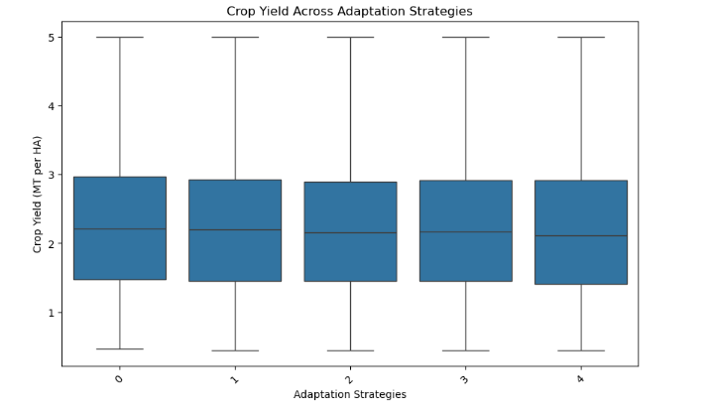
Observations
All adaptation strategies have very similar median crop yield values (around 2.1–2.2 MT/HA).
The spread of crop yield is nearly identical across all adaptation strategy groups.
The interquartile ranges (box heights) are very similar.
Maximum crop yield values are approximately 5 MT/HA for all groups.
Minimum crop yield values are approximately 0.5 MT/HA for all groups.
No adaptation strategy appears to consistently produce higher crop yields than the others.
The distributions largely overlap, indicating similar productivity patterns across strategies.
Results
The boxplot suggests that crop yield distributions are very similar across all adaptation strategy groups. This visual observation supports the Kruskal–Wallis Test result:
H Statistic = 4.191
p-value = 0.381
Since:
p-value = 0.381 > 0.05
the null hypothesis cannot be rejected.
Therefore:
There is no statistically significant difference in crop yield among the adaptation strategies included in the dataset.
What does the Boxplot Show?
X-axis: Adaptation Strategies (coded as 0, 1, 2, 3, and 4)
Y-axis: Crop Yield (MT per HA)
Each box represents the distribution of crop yield for a particular adaptation strategy.

Slide 16
03
Tools & Methodology
Software, Libraries, and Statistical Techniques

Slide 17
Software and Python Libraries
Python
Core Libraries
Excel
• Primary programming language
• Powerful data analysis libraries
• Statistical computing support
• Machine learning integration
Jupyter Notebook
• Interactive development
• Visualization & documentation
• Pandas - Data preprocessing
• NumPy - Numerical computing
• Matplotlib - Graph plotting
• Seaborn - Statistical viz
ML & Stats
• Scikit-learn - Regression
• SciPy - Hypothesis testing
Preliminary Use
• Dataset inspection
• Data verification
• Structure review
Source
Microsoft Excel for data understanding
13

Slide 18
Statistical Methods Overview
Method | Purpose | Outputs | Evaluation
Pearson Correlation | Measure strength and direction of relationships | Correlation Matrix, Heatmap, r values | r = 0.264 (temp)
Multiple Linear Regression | Examine combined impact of climate variables | Regression Model, R2, MAE, RMSE | R2 = 0.0679
ANOVA | Compare productivity across groups | F-statistic, p-value, Eta Squared | Not Significant
Trend Analysis | Identify long-term changes over time | Trend Plot, Trend Slope | Stable trend
Kruskal-Wallis Test | Evaluate adaptation strategies | H-statistic, p-value, Epsilon2 | Not Significant
14

Slide 19
04
Conclusion
Key Findings and Future Implications

Slide 20
Key Findings and Conclusions
1
Correlation: Temperature showed the strongest positive link with crop yield (r = 0.264)
2
Regression: Climate variables collectively influence productivity (R2 = 0.0679)
3
ANOVA: No statistically significant differences in crop yield across countries, regions, or crop types
4
Trend: Crop yield patterns remained relatively stable with only slight fluctuations over time
5
Kruskal-Wallis: No significant differences in crop yields among adaptation strategies analyzed
Implication: These findings offer crucial insights for policymakers, agricultural planners, and farmers to develop climate-resilient strategies
16

Slide 21
Thank You

